Slide 1


Why C Programming Language is the Mother of All Programming Languages
Presenters: Manav Nalkande, Chaitanya Nikam, Aryan Kharwade, Ayush Manjrekar, Henin Rio M
PRN: 126222526, 126223562, 126223835, 126221824, 126221978
Course: Btech Computer Science ( CyberSecurity and Forensics )
Division: 13
College Name: MIT WPU
Subject Name: Foundations of Programming

Slide 2

CHAPTER 1
Introduction to C: The Foundation
C is a powerful, general-purpose programming language.
It was developed by Dennis Ritchie at Bell Labs.
Its creation dates back to 1972, revolutionizing software development.
Initially designed for system programming, particularly for the Unix operating system.
Provided unprecedented control over hardware, bridging the gap between low-level assembly and high-level languages.

Slide 3

CHAPTER 1
The Genesis and Purpose of C
C was created to rewrite the Unix operating system from assembly language.
Aimed to achieve high performance while maintaining portability across different hardware.
Its development was a response to the limitations of earlier languages like B and BCPL.
Played a crucial role in the evolution of software engineering and operating systems.
Enabled the widespread adoption of Unix and subsequently, the internet infrastructure.

Slide 4
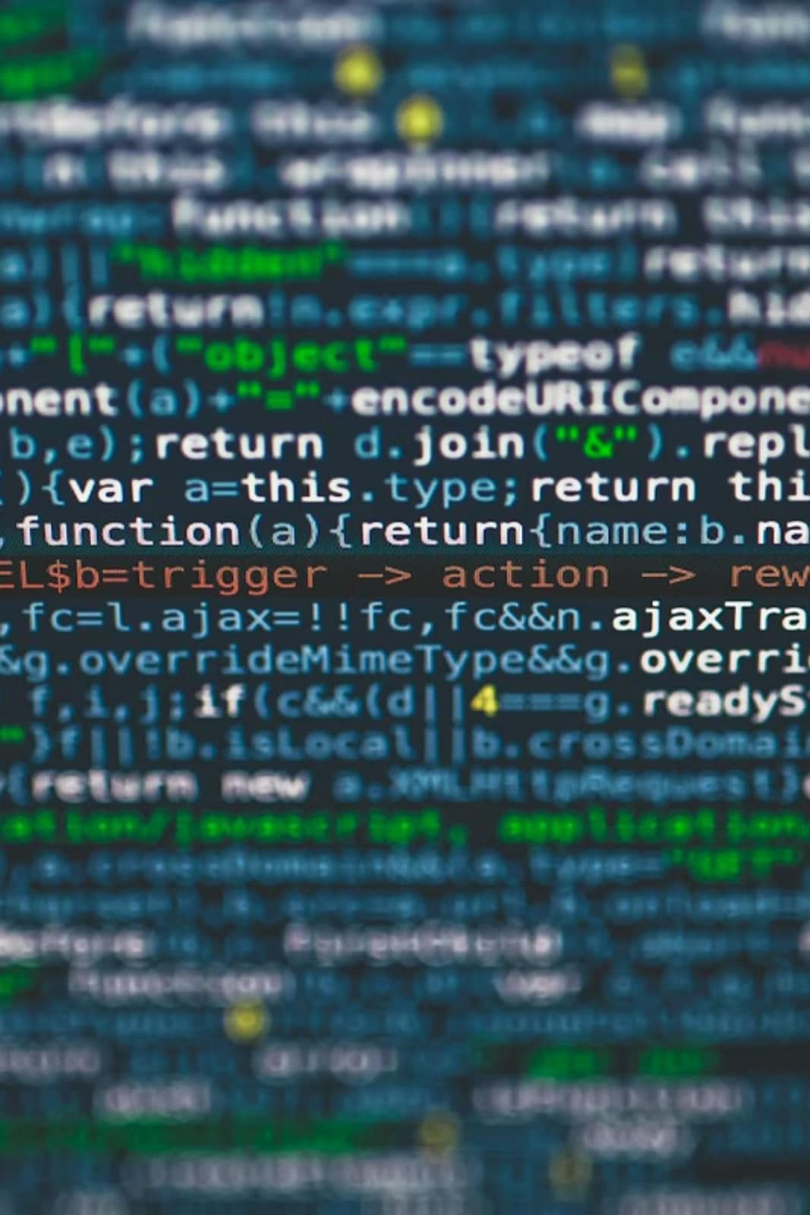



CHAPTER 2
Core Features of C: Power and Flexibility
r
Structured Programming
Low-Level Memory Access
C supports clear, modular programming through functions and control structures.
Pointers allow direct manipulation of memory, crucial for system-level tasks.
Portability
C programs can be compiled and run on diverse hardware platforms with minimal changes.

Slide 5
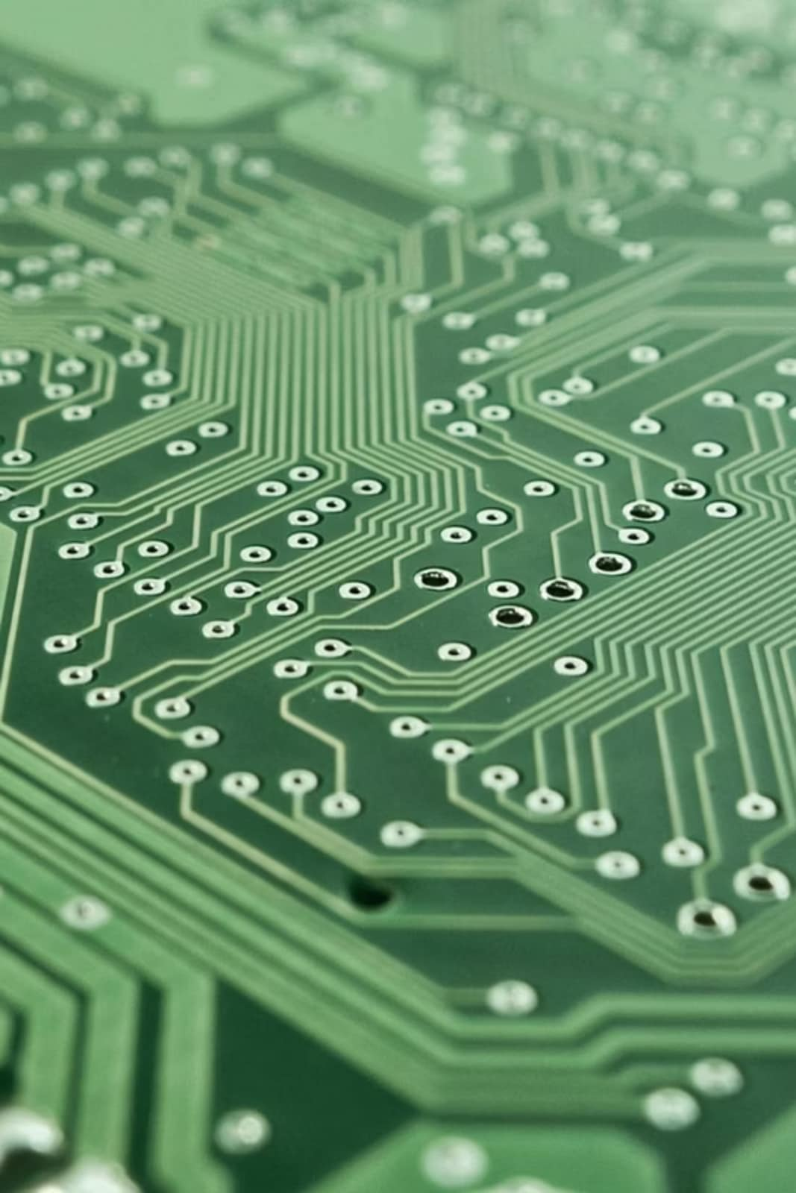
CHAPTER 2
Efficiency and Applications of C
Known for its exceptional efficiency and speed, often matching assembly language performance.
Minimal runtime and memory overhead make it ideal for performance-critical applications.
Widely used in system programming, including operating systems, compilers, and device drivers.
Its simplicity and direct control make it a preferred choice for embedded systems and real-time applications.
Continues to be foundational for high-performance computing and resource-constrained environments.

Slide 6
CHAPTER 3
C's Enduring Influence: A Linguistic Legacy
C++
Object-oriented extensions built directly on C.
Java
Inherited syntax and many foundational concepts.
Python
Interpreters often written in C; shares control flow.
C#
Microsoft's modern language, heavily influenced by C and C++.
JavaScript
Syntax borrowed extensively, making it familiar to C programmers.

Slide 7
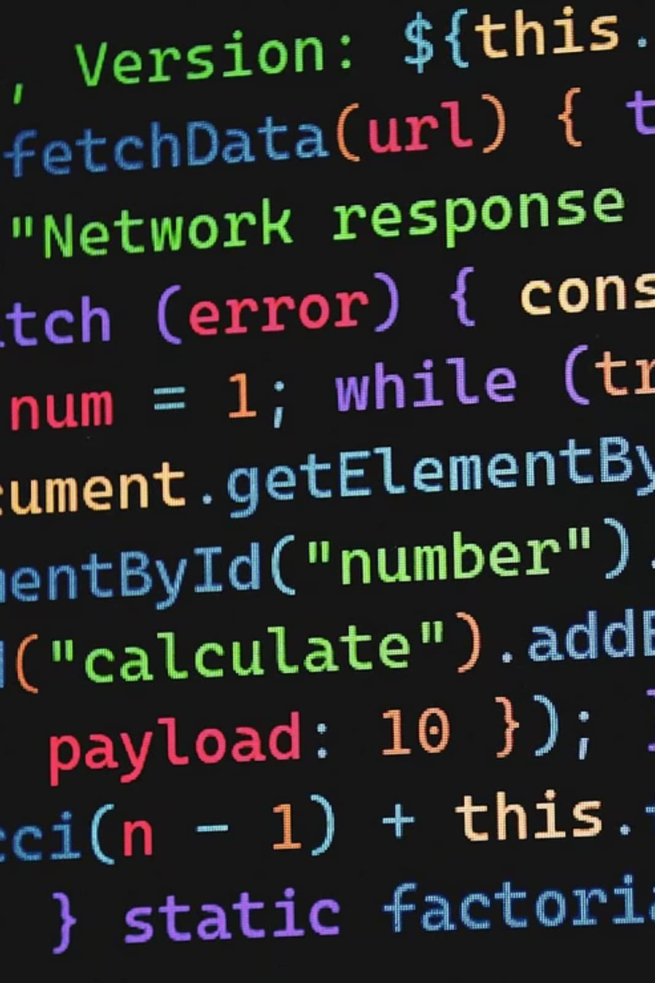
CHAPTER 3
Syntactic and Conceptual Offspring
Many modern languages adopt C's bracket-based syntax for code blocks.
Concepts like variables, data types, loops, and conditional statements are directly transferable.
Memory management principles (though often abstracted) have roots in C's explicit approach.
Function definitions and parameter passing mechanisms are ubiquitous across C-derived languages.
Learning C provides a strong intuitive understanding of how these successor languages operate under the hood.

Slide 8

CHAPTER 4
The Mother Language: C's Fundamental Role
C serves as the bedrock for many modern operating systems like Linux, Windows, and macOS.
It is the primary language for developing compilers and interpreters for other programming languages.
Essential for embedded systems development, from microcontrollers to IoT devices.
Underpins critical system utilities and high-performance applications where speed is paramount.
Its direct interaction with hardware makes it indispensable for device drivers and kernels.

Slide 9
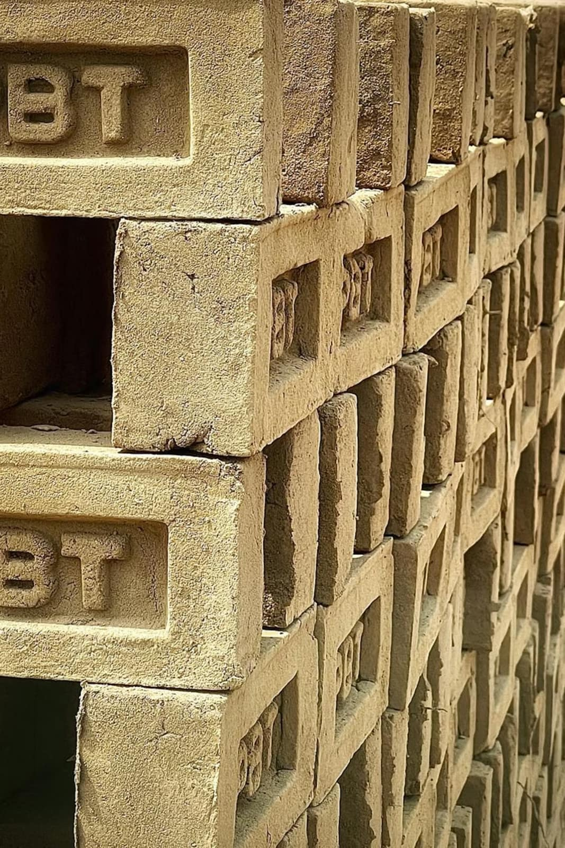
CHAPTER 4
Building Strong Programming Basics with C
Learning C instills a deep understanding of computer architecture and memory management.
It teaches fundamental concepts that are often abstracted away in higher-level languages.
Develops problem-solving skills and logical thinking crucial for any programmer.
Provides a strong basis for debugging and optimizing code, improving overall programming proficiency.
Mastery of C equips developers with the ability to write efficient, robust, and performant software.

Slide 10

Conclusion: C's Enduring Legacy
C's foundational principles continue to shape the landscape of computer science.
It remains relevant for performance-critical applications and system-level programming.
Understanding C is key to truly grasping the internals of computing systems.
Its influence will persist as new languages and technologies emerge, built upon its established paradigms.
Thank You for your attention!

Slide 11
